Slide 1
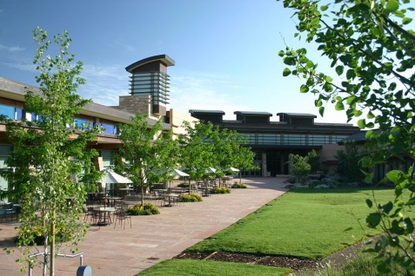
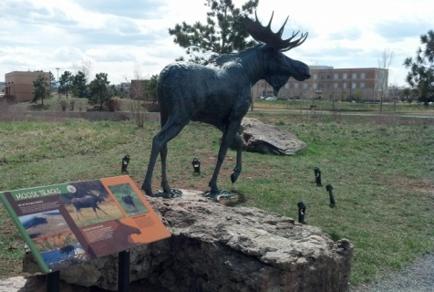
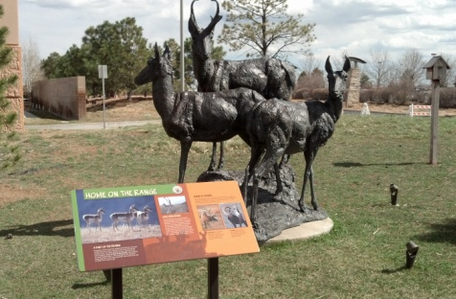

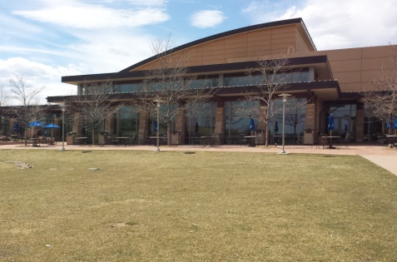
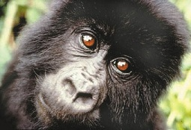
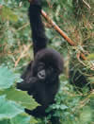
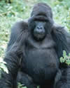
Fundraising
Toolkit

Slide 2
Fundraising Instructions
Online donations:
During online registration through https://secure.getmeregistered.com/get_information.php?event_id=10841 you have the option to create a fundraising page.
If you did not choose this option during registration, no problem! You can still create a fundraising page by visiting https://secure.getmeregistered.com/get_information.php?event_id=10841 and clicking “Become a Fundraiser.”
Personalize your fundraising page to include:
  Your fundraising goal
  Why you are participating in the Gorilla Trek
  Include any personal connection to the mountain gorillas
  Upload images (gorilla pictures, etc.)
Share your fundraising homepage link to all your friends and family! For your convenience, we’ve provided a pledge letter template.
On your fundraising page, click on the “Tell others about this event!” buttons to let you Facebook friends and Twitter followers know about your fundraising efforts!
Remember you are eligible for great fundraising pledge incentives!
For additional help and support, email saveagorilla@yahoo.com with questions.
Offline donations:
You can also collect cash donations or checks made payable to MGCF. Record fundraising dollars on the pledge form and drop off at the donations table on event day.

Slide 3
Pledge Letter to Send to Supporters
Hi There!
Since most people can't make it to the jungles of Africa, we are pretending the jungles are in Parker, CO. The Mountain Gorilla Conservation Fund is hosting the Gorilla Trek and all of us are helping to keep Dian Fossey's dream alive. Remember the movie "Gorillas in the Mist"?
I am raising funds for the Mountain Gorilla Conservation Fund and am asking you to help by making a contribution. I’ve set a personal fundraising goal of $[INSERT GOAL]. Please visit [ADD PERSONAL FUNDRAISING PAGE WEBLINK HERE] to donate online quickly & securely. Or, why not join me on the day of the event? Visit www.gorillaevents.com/gorillatrek to register today.
Why are we doing this?
MGCF needs to expand its veterinary program by educating local Ugandans and Rwandans to become veterinarians. The current facility at Makerere University has outgrown itself and we need more room to further the education of locals to first, protect the mountain gorilla, then expand to other wildlife in Uganda and Rwanda. MGCF needs support in raising funds to build a new expansion that will provide new lecture halls and a wildlife museum to conserve gorilla remains for future studying. MGCF was the first in the world to ever build an "on location" vet center in 1986 for the protection of endangered animals. Since then, 20 expatriate veterinarians have served in the countries and now locals have been educated enough to take over and protect their own wildlife. This is a great thing for central Africa!
I thank you in advance for your support and really appreciate your generosity!!
The Gorilla Trek main web site: www.gorillaevents.com/gorillatrek
If you would like more information about the Mountain Gorilla Conservation Fund and how funds raised through the Gorilla Trek are used, please visit www.saveagorilla.org.
Please forward this email to as many people as you can and encourage them to donate!

Slide 4
Fundraiser Checklist
HAVE A PLAN AND STICK TO IT
The most effective way to achieve your fundraising goal is to create a detailed plan outlining the steps you'll need to complete in order to meet your objectives. Remember, sticking to your plan will ensure success!
Set a goal of at least $250.
Start early so you can give people ample time to donate.
Make it personal. Educate your donors on why this cause is so important to you.
Stress the benefits of contributing.
Ask BIG before going small.
Never feel guilty about asking for donations.
Keep track of who you’ve asked and follow-up.
Always ask contacts to forward your email to others.
Keep donors updated on your progress.
Ask, Ask, Ask!
Send thank you notes!
Don’t be afraid to ask everyone you know
Start by making your own contribution!
Friends, family members, and co-workers. You never know who is willing to contribute!
Ask your employer if they have a matching gift program or would be willing to make a corporate donation…have your donors ask their employers too!
Email local businesses that might be interested in your cause. Ask them to sponsor you.
Use social media
Update your Facebook status to let your friends know you are raising money for the mountain gorillas.
Tell your Twitter followers about your fundraising efforts.
Keep everyone up to date on progress towards your goal.
Set a Fundraising Goal
I will raise $ (we recommend $250.00) by July 12, 2014.
I will contact people in order to reach my goal.
Estimate the average contribution will be $50 and that 50% of the people you contact
will contribute. If you plan to raise $250, you only need to contact 10 people. Simple!

Slide 5
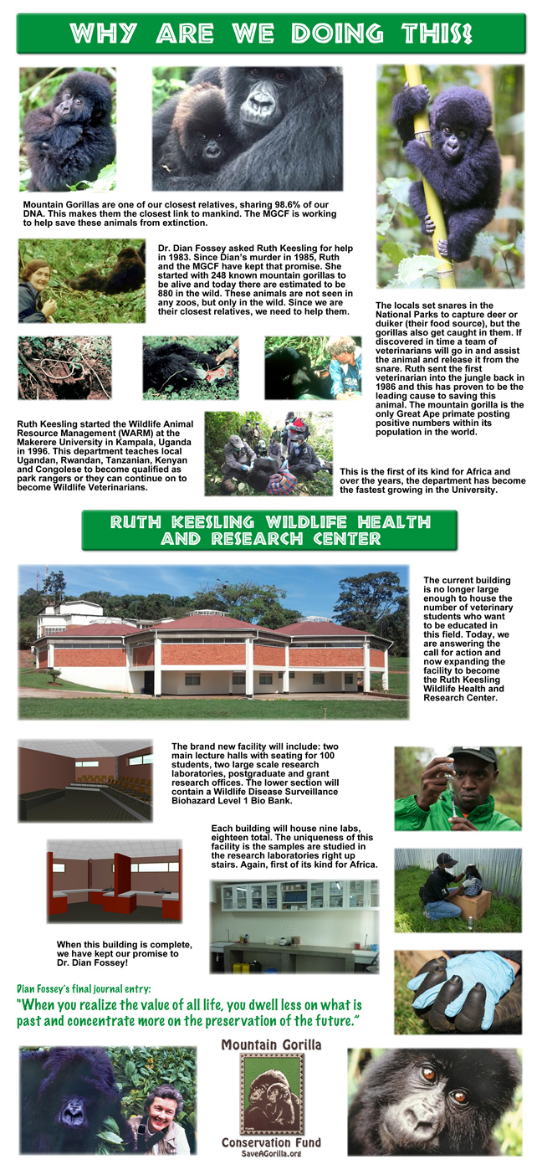

Slide 7
Pledge Form
Gorilla Trek July 12, 2014
Participant Name: ______________________ Team Name: _____________________
Address: _____________________________________________________________
City: _____________________________ State: ___________ Zip Code: _________
Phone Number: ________________________ E-mail: ________________________
Cash
Check
Sponsor’s Name | Address / City / State / Zip | Email | Amount Pledged
 |  |  |  | □ □
 |  |  |  | □ □
 |  |  |  | □ □
 |  |  |  | □ □
 |  |  |  | □ □
 |  |  |  | □ □
 |  |  |  | □ □
 |  |  |  | □ □
 |  |  |  | □ □
 |  |  |  | □ □
 |  |  |  | □ □
 |  |  |  | □ □
 |  |  |  | □ □
 |  | Total
  Please make checks payable to: MGCF
Bring this form to the Gorilla Trek on July 12, 2014.
The donor’s name and address or email must be clearly printed and complete on the form above to receive a tax receipt from Mountain Gorilla Conservation Fund.

Slide 8

Pledge Incentives
Raise this amount | …to receive
$25 | 3 tickets for the prize drawing
$50 | 7 tickets for the prize drawing
$75 | 11 tickets for the prize drawing
SILVERBACK DRAWING
Raise this amount | …to receive
$100 | 1 ticket for the SILVERBACK drawing
$150 | 2 ticket for the SILVERBACK drawing
$200 | 3 ticket for the SILVERBACK drawing
$250 | 4 ticket for the SILVERBACK drawing
**The SILVERBACK prize drawing is reserved for donors & fundraisers over $100, so you'll have more chance to win!**

